Slide 1
19239 E-FLY Edge-enabled Flying Inspector
Ana Juan Ferrer
Madrid, July 24th 2019

Slide 2
E-FLY Edge-enabled Flying Inspector, e-fly.eu
Today only 5% of data created by Unmanned Aerial Vehicles (UAV) is processed due to bandwidth and connectivity limitations.
A small drone fleet could easily create 150 terabytes of data per day

Slide 3
E-FLY Edge-enabled Flying Inspector, e-fly.eu
E-FLY overcomes these limits by exploiting benefits of distributed UAV Data AI processing across UAV, Edge and Cloud, and provides a framework for UAV-based inspection of Critical Infrastructures such as gas pipelines, roads, rail, and electric lines.

Slide 4
E-FLY Edge-enabled Flying Inspector, e-fly.eu
Ability to exploit data gathered from UAVs will soon become an urgent need.
Edge computing acts as the ground-breaking technology that can make this happen.
Benefits of E-FLY are applicable to diverse infrastructure inspection cases (gas, powerlines and roads) and other sectors (delivery and traffic control).

Slide 5
E-FLY Edge-enabled Flying Inspector, e-fly.eu
Cloud
services
Edge computing locates computing and storage resources at the Edge of the network
“getting data and computation at the right place and right time in a more decentralized manner” to avoid not essential data transmissions over the network
Gartner defines edge computing as “solutions that facilitate data processing at or near the source of data generation”
Edge nodes
IoT devices

Slide 6
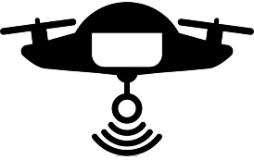
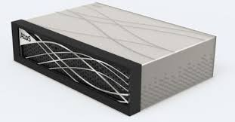
E-FLY Edge-enabled Flying Inspector, e-fly.eu
computation
off-loadding
computation
off-loadding
UAV
Edge Computing
Cloud
Computing
UAV
E-FLY builds a framework that combines AI-enabled image processing distributed across three different execution environments, UAV, Edge and Cloud.

Slide 7
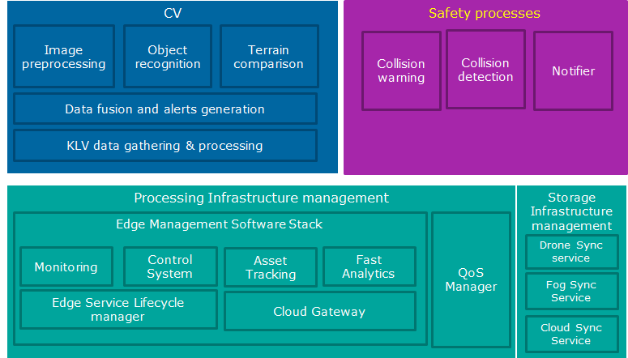
E-FLY Edge-enabled Flying Inspector, e-fly.eu
Computer Vision (CV) identifies and geolocates objects or situations that imply a risk to the structural integrity of the infrastructure for which it has been trained.
Safety Processes assist the UAV pilot (operator) in the safe operation of the drone, specifically, to avoid the collision with any object which may get into the UAV navigation path.
Storage and Processing Infrastructure Management components are responsible for provisioning of computational and storage capabilities in the resources located at the Edge of the network.

Slide 8
E-FLY Edge-enabled Flying Inspector, e-fly.eu
Benefits of E-FLY are applicable to diverse infrastructure inspection cases (gas, powerlines and roads) and other sectors (delivery and traffic control).
Utilities and Services Companies
Critical Infrastructure Operators/Owners – Oil & Gas, Electricity, Railway, Roads, Water, etc
Delivery and Traffic Control Operators
Managed Surveillance and Monitoring Companies

Slide 9
E-FLY Edge-enabled Flying Inspector, e-fly.eu
Status
Developing our initial prototype
Overall E-FLY architecture defined out of existing building blocks
Initial flights for Computer Vision performed
Experimentation over limited Edge devices equipped with GPUs with Azure IoT Edge and AWS Greengrass

Slide 10
E-FLY Edge-enabled Flying Inspector, e-fly.eu

Slide 11
E-FLY Edge-enabled Flying Inspector, e-fly.eu
Contact:
Ana Juan Ferrer, E-FLY Activity Leader
e: ana.juanf@atos.net
t: +(34) 625599181

