Slide 1
19239 E-FLY Edge-enabled Flying Inspector
Jose-Ramon Martinez-Salio
EIT-Digital Workshop
EIT Digital Madrid Node
24th of July 2019

Slide 2
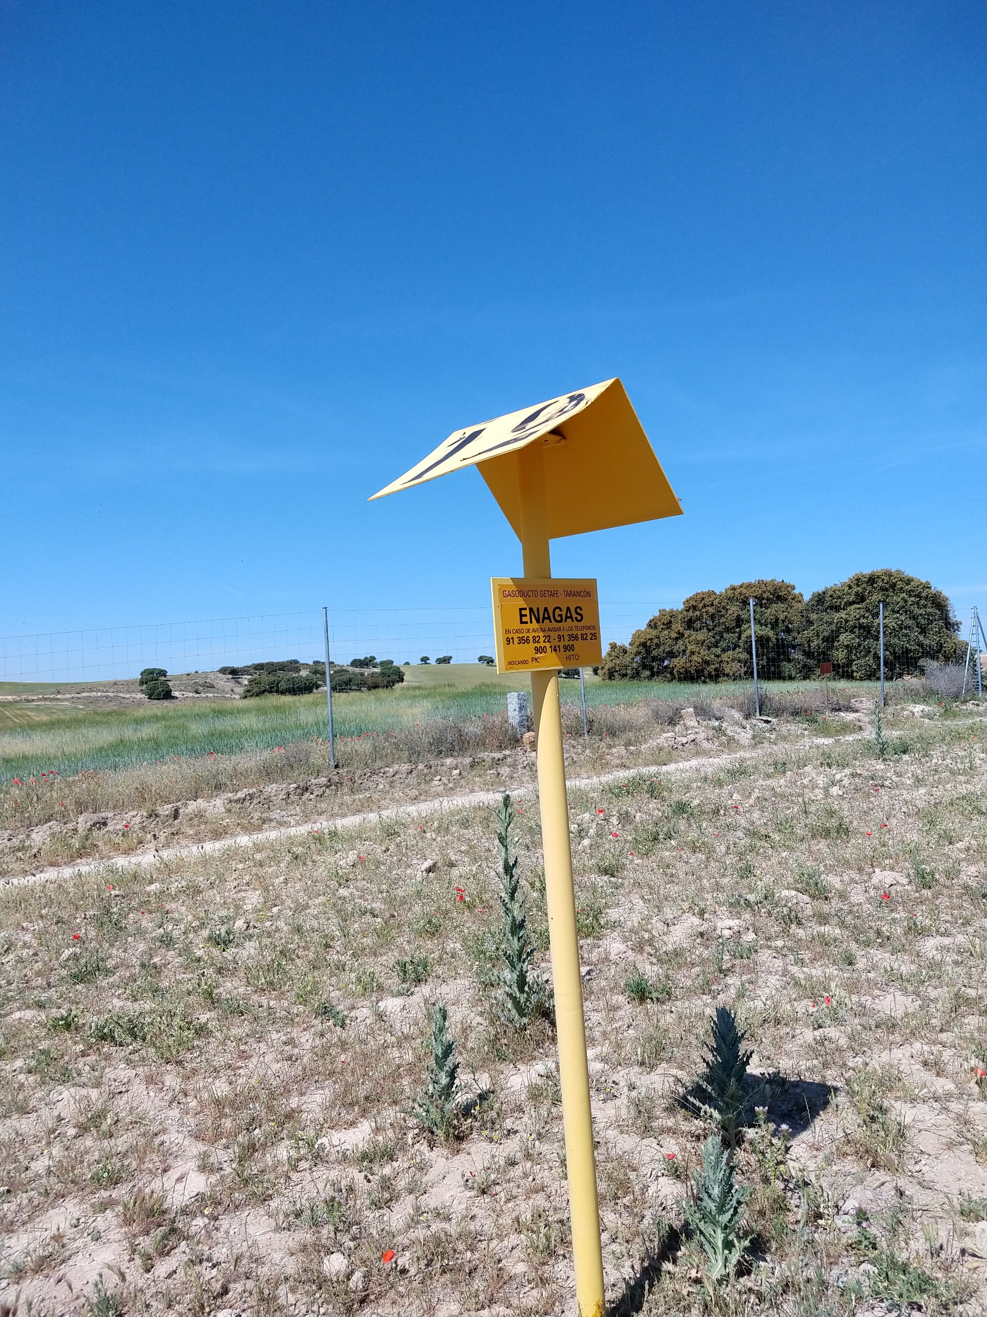
Technical challenge
Automatic detection of anomalies in pipeline
Area of interest
Gas pipeline and 25 meters each side
No construction/excavation/high vegetation
Elements to be detected:
“Elements” near gas pipeline: Cars and trucks
Fire/burnt areas over pipeline area
Geological damage (excavation, landslides)
Trees and vegetation (big) over pipeline
Gas leakage (color of terrain)
Pipeline landmarks status (no tampering)

Slide 3
Requisites and realities
Initial intention:
Use real time footage of AUV
On board
On the Ground Station
As close as real time as possible
Restrictions of the problem:
No real time processing on board is possible
Use of deep learning is restricted due to lack of training data
Fire
Geological damage
Gas leakage (color of the terrain)

Slide 4
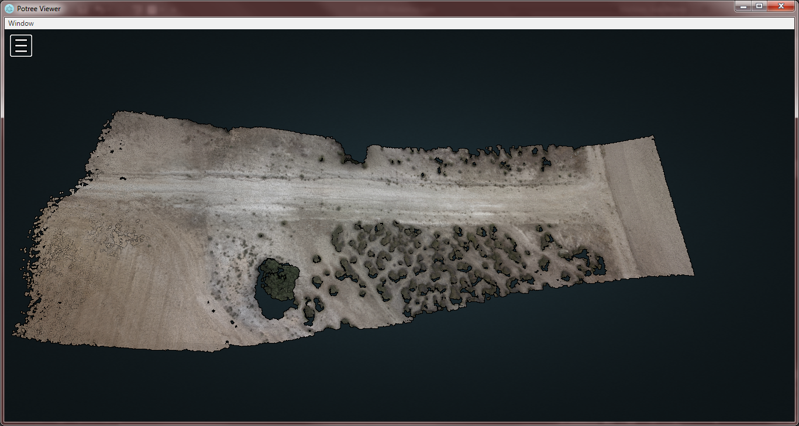
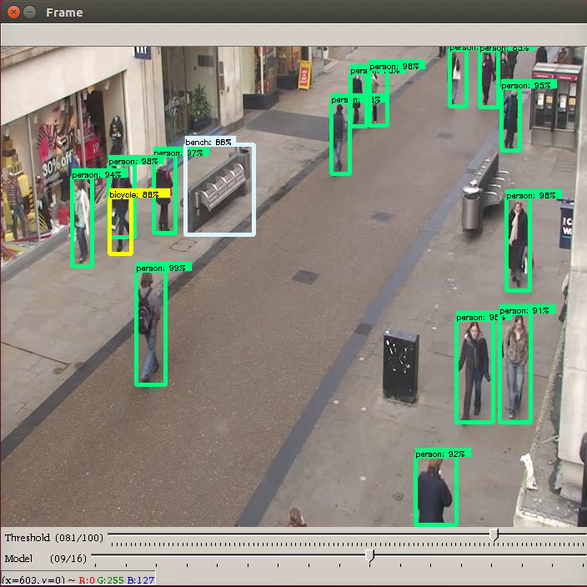
The right tool for the right detection
Technical solution:
“Classic” detection of objects:
Cars and trucks
Trees and vegetation (not used at the end)
Status of landmarks
Comparison of “baseline” of terrain:
Fire: burned areas
Geological damage
Trees and vegetation over pipeline
Gas leaks (terrain color)

Slide 5
Baseline solution
Idea is to compare a “baseline” terrain
Need to create a “clean” baseline
Via drone flight
Via google earth
Via satellite images (not in scope)
Terrain comparison
Detect differences by subtraction
Use deep learning to identify (optionally)
Result is a clear alternative to LIDAR analysis with visual perspective

Slide 6
Identification of anomalies by georeferenced image comparison
Telemetry data, in MavLink format and zenithal video of the area is acquired.
Synchronization of telemetry and video data. Both will have the same sample rate. (5 Hz, as GPS data)
Assignment to each frame of its GPS position, latitude, longitude and height.
Applying motion structure algorithms we will generate the 3D model of the scene and the georeferenced orthophoto.
By means of computer vision algorithms we will identify the areas of the images where there are differences.
By comparing 3D models, changes in terrain can be identified.

Slide 7
Deep learning solution
Deep learning:
We will use TensorFlow or Caffe trained net to detect:
Detection of vehicles, cars and trucks
Status of landmarks
Detection of cars/trucks is “out of the box”
Detection of Landmarks need to be trained

Slide 8
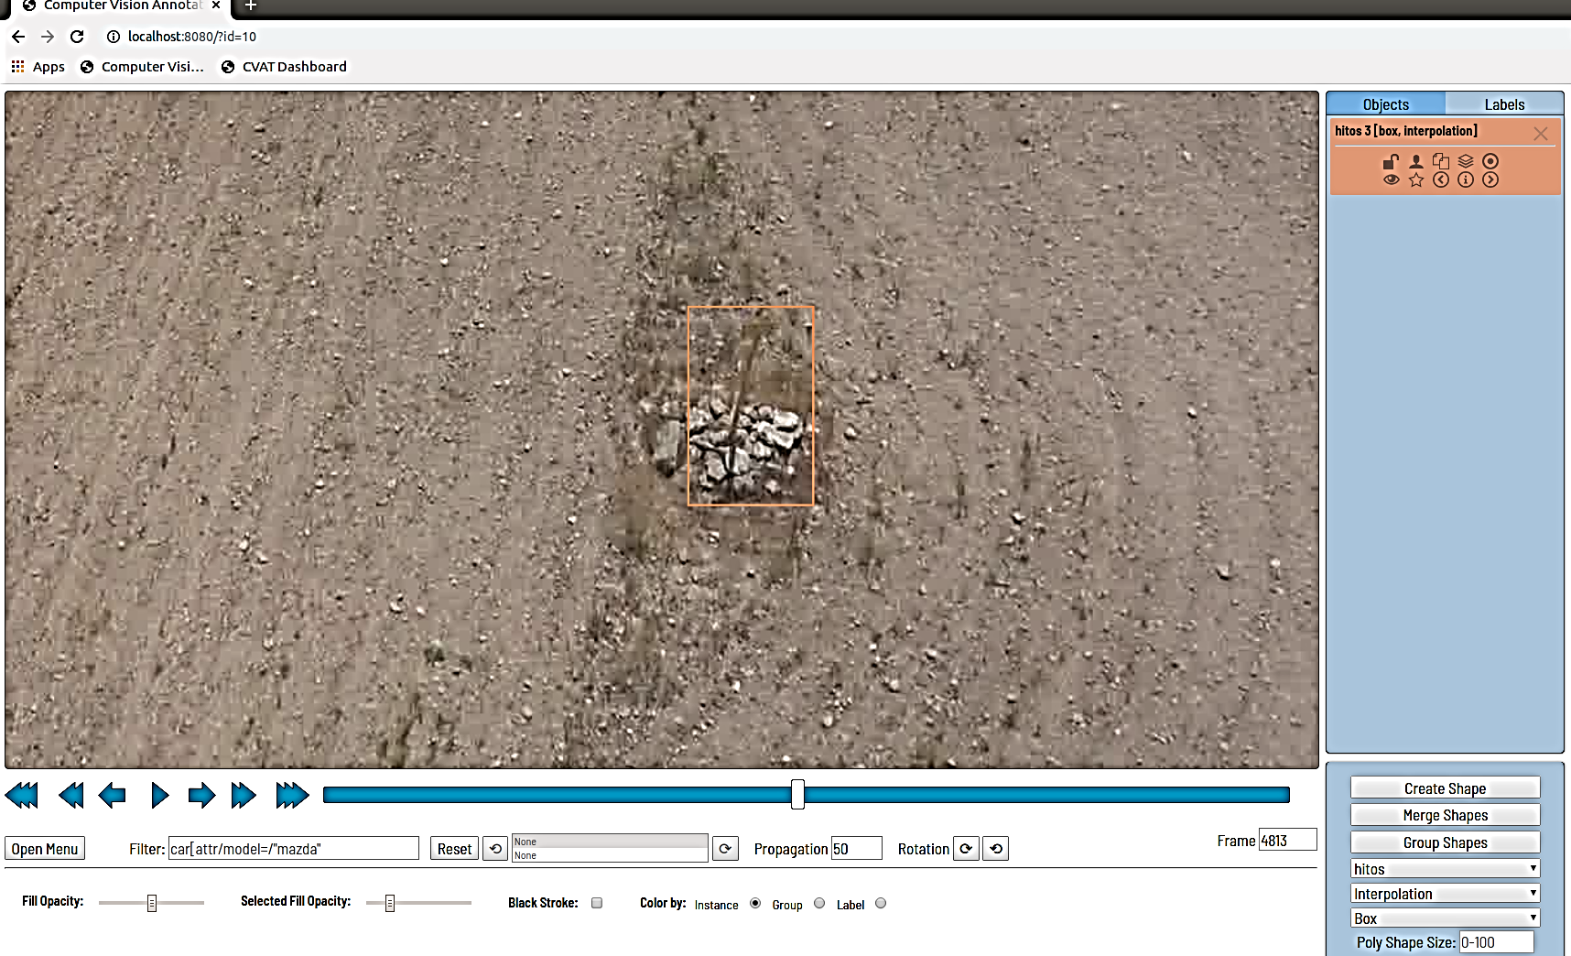
Landmarks detection
Out-of-the-box solutions are not detecting it
Need to train a new net
Need to create a training set
Have asked for videos (15 m height)
Have tagged landmarks in the videos using CVAT
TO DO:
Choose right net; inception or similar
Train the net

Slide 9
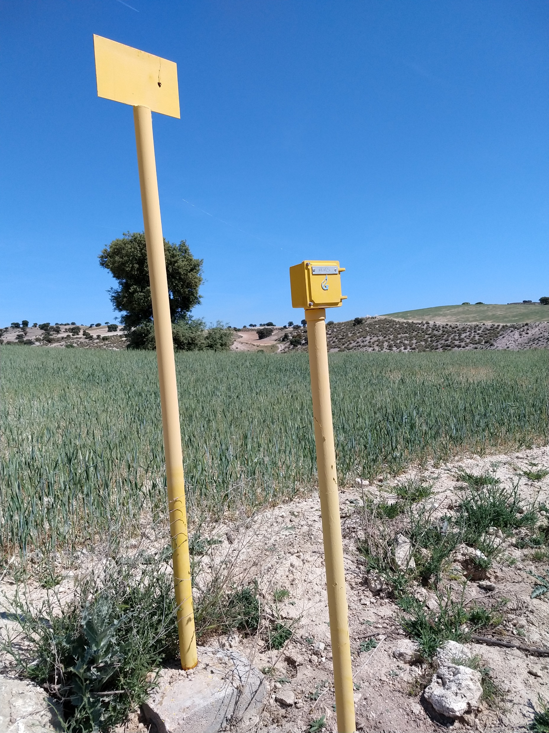
Final E-fly pilot: what is possible
In the pilot we will detect:
Elements near gas pipe: Cars and trucks
Fire: for the demo a simulated area not over pipeline using colored area
Fire is not possible to be started for the demo
Simulated geological damage;
Small excavation not over pipeline
Trees and vegetation over pipeline
Using bushes and branches
Simulated gas leaks
Colored area
Landmarks detection and “status”
We will use a “fake” landmark

Slide 10
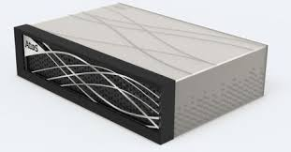
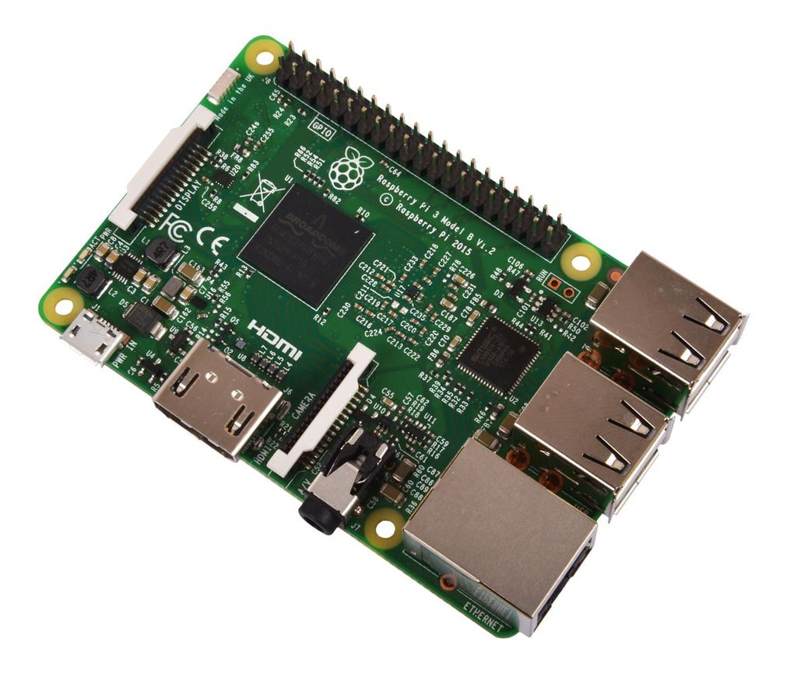
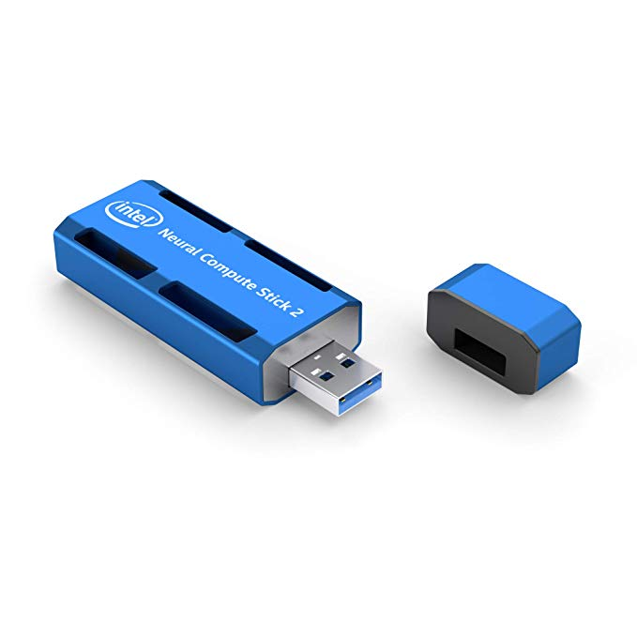
Pilot Experimentation
Experimentation on:
Measurements in order to generate tradeoffs among:
UAV processing – Simulated with constrained devices(Raspberry Pi) equipped with GPU processors
Edge processing on dedicated devices
Atos BullSequana Edge
More limited Edge Devices (Raspberry Pi)
Equipped with GPU processors (Intel Mobidious)
Not equipped with GPU processors

Slide 11
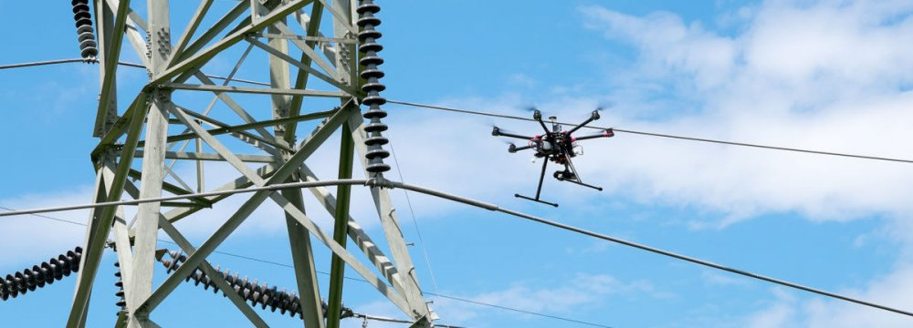
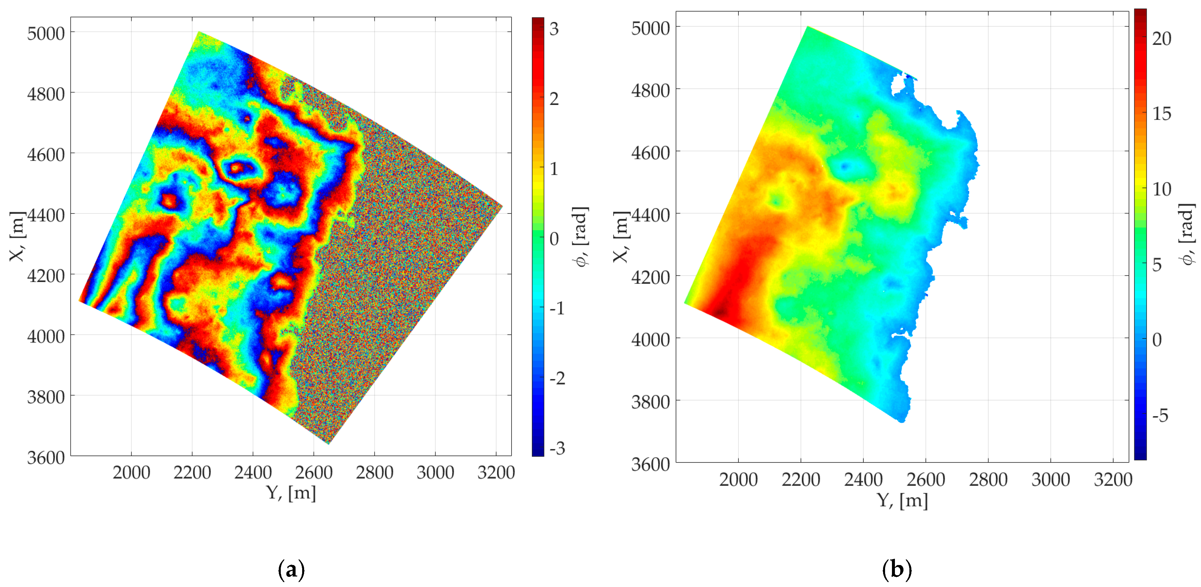
Further extension of the solution
The terrain comparison solution can be extended to many markets
For CI protection
Gas pipelines
Petrol pipelines
Electric grids
Roads slope
For other uses
Earthquake interferometry
Movements of terrain
Satellite extension

Slide 12
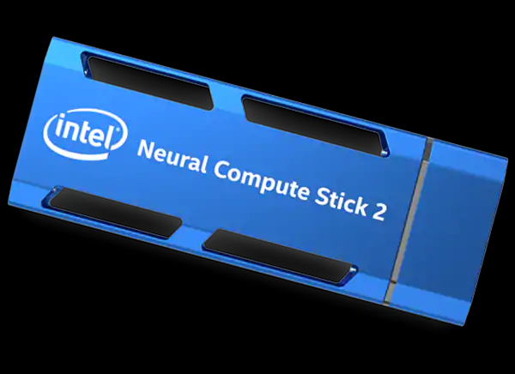
Annex: On board processing: testing the future
We will test the on board processing on the “ground station”
There is no technical difference: just the transport latency
No onboard processing is possible due to software limitations for the UAV that we are using
Idea is to process “deep learning” solutions:
As close to the UAV as possible
As close to real time as possible
We will use a Intel Neural Compute Stick 2
API is still limited

Slide 13
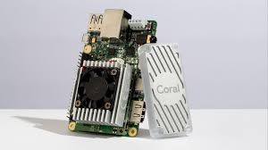
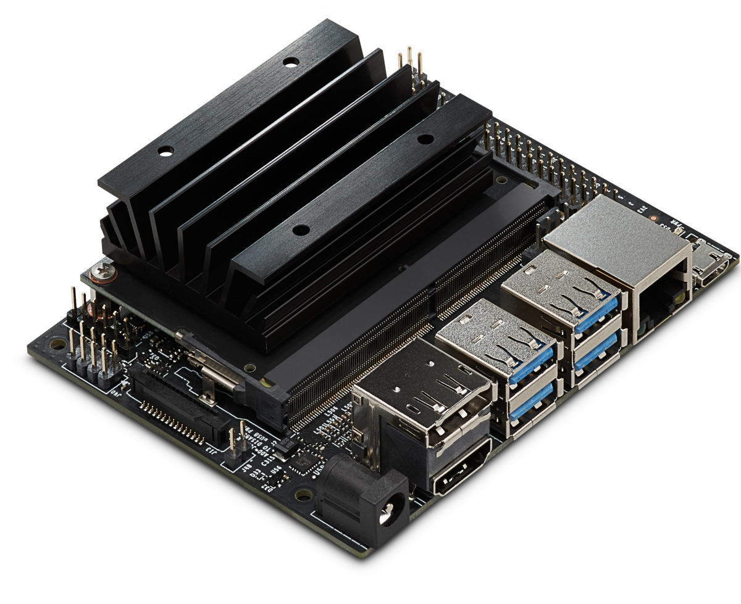
Annex: Battle of Edge AI processor Nvidia vs Google vs Intel
Edge AI processor means that AI algorithms are processed locally on a hardware device: on board of a UAV, a IoT device, a self phone, etc
“UBS like” solutions
“Rasberry PI like” solutions
Is a big battle going on. The booty is huge: All IoT devices
There are three main challengers
Nvidia Jetson Nano
Google Coral
Intel Neural Stick 2
Is still “limited” in APIs and functionality
Now is running “second” iteration
Will be mature in 1-2 years

Slide 14
Terrain comparison Demo

Slide 15
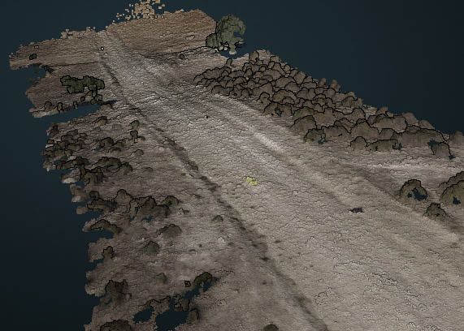
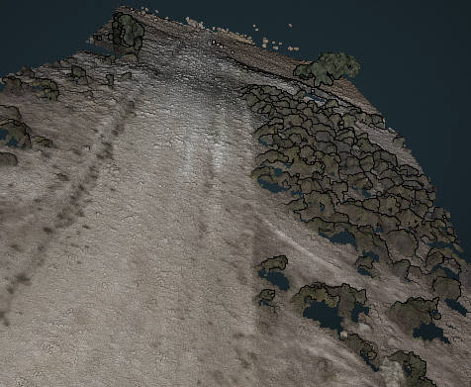
B)
3D Images built using drone footage and geopositioned using Maplink data
A)
Flight 2, 13-06-2019:10:56:00 (Villa Manrique, Spain)
Flight 3, 18-06-2019:11:28:30 (Villa Manrique, Spain)

Slide 16
A)
B)
Flight 2, 13-06-2019:10:56:00 (Villa Manrique, Spain)
Flight 3, 18-06-2019:11:28:30 (Villa Manrique, Spain)

Slide 17
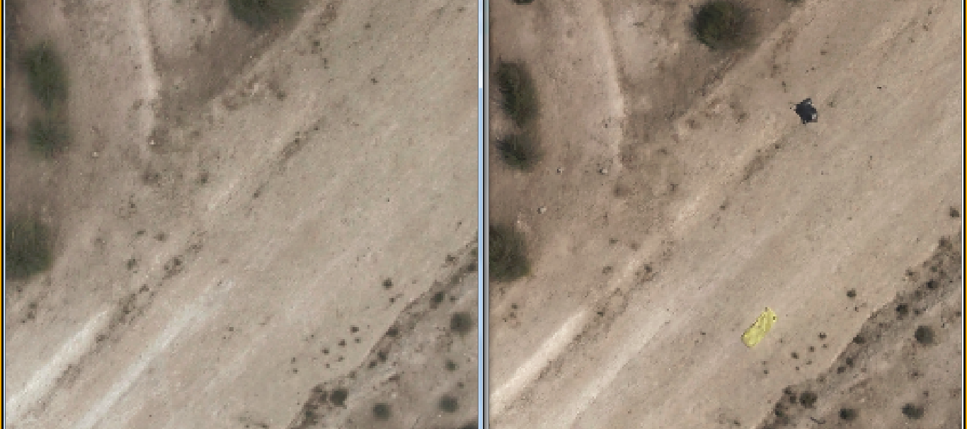
If we use only GPS data to compare images we don't get good results due to GPS positioning errors.

Slide 18
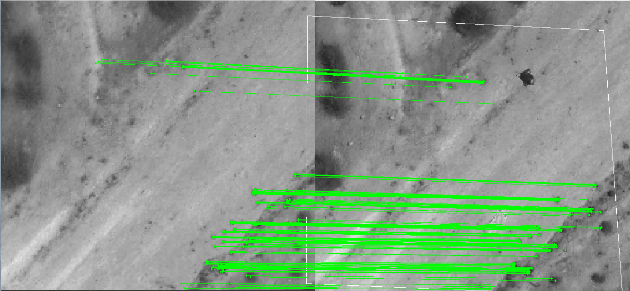
It is necessary to make a homography between images based on invariant feature-based image matching, filtering in this way all the differences between images due to differences in zoom, height, deviation from local horizon and GPS errors.

Slide 19
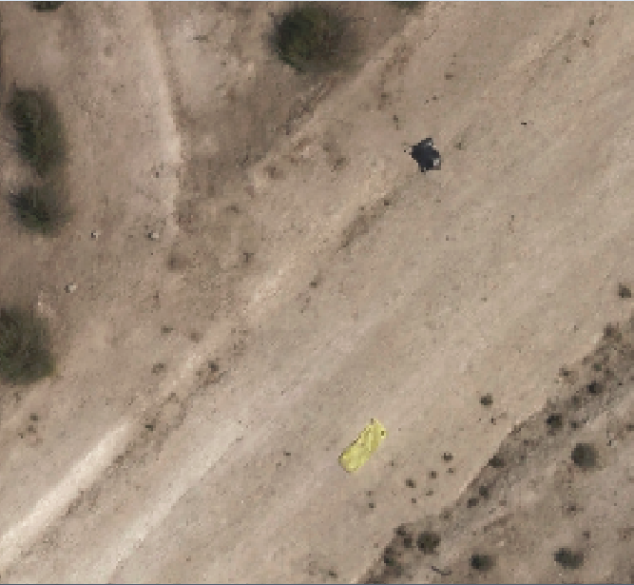
Now we can make the comparison of the images, when both are projected in the same plane.
We can choose the size of the different minimum surface we want to identify.
The differences will be labeled and georeferenced.

Slide 20
Thank you for your time! Q&A

Slide 21
Thank you!
Contact Information
Jose Ramon Martinez
jose.martinezs@atos.net

